Slide 1
Herman Kolstad Jakobsen
MQ Summit, Haarlem NL
22.10.2026
Controlling the Norwegian power grid in real-time with Apache Kafka

Slide 2

Who am I?
Controlling the Norwegian power grid in real-time with Apache Kafka
Working as a consultant at Systek
Been at Statnett (Norwegian TSO) for the last 5 years
Currently a Tech Lead in one of Statnett’s product teams handling sensor data in real-time
Proposed and implemented KIP-1146: Anchored punctuation
Notes:
So to get the formalities out of the way…

Slide 3
04.03.2025 - 13:00
Notes:
On the 4th of March last year, at one o'clock, we deployed the largest change in how the Nordics controls the power grid in over 30 years. This change was also the largest digital change that Statnett, the Norwegian Transmission System Operator (TSO), had seen for over 70 years!
So, on the 4th of March we went from frequency based control to controlling the power grid based on the power imbalance in each price area. Instead of continously monitoring the frequency in the power socket, the control loop is now built on forecasts of the imbalance between production and consumption in each bidding area.

Slide 4

Notes:
The deployment of the change can be compared to sitting on an airplane on its way here to the Netherlands, and the captain suddenly says on the intercom: "Hi ladies and gentlemen, we will now have to change the jet engines".

Slide 5

Notes:
In confusion and disbelief, you take a peek out of the window. And to your surprise, the engine is in fact gone. You feel the plane slowly starting to fall against the ground and your heart rate races. You blink your eyes – and boom…

Slide 6

Notes:
A new and better engine has been installed, and you can feel the plane start to stabilize. "That was pretty crazy!", you think to yourself. And yes, it was pretty crazy to deploy the new control loop! And what could be the consequences if the deployment or the new control algorithm failed?

Slide 7
Notes:
Total darkness in the Nordics! So the stakes were high, to say the least. And the technology basically powering it all?

Slide 8

Notes:
Our beloved Apache Kafka!
But let's take a step back first, what exactly is the new control loop?

Slide 9

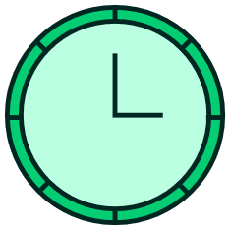




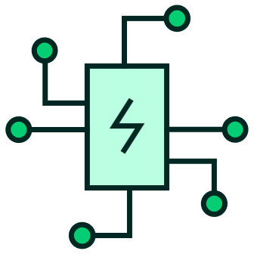
Control loop
1 hour
15 minutes
50 Hz
Manual
Automatic
Notes:
In order to keep 50 Hz in the power socket, and not break any plugged in electrical equipment or devices, there needs to be balance between power production and power consumption. Electrical power is fresh and must therefore be used instantly, meaning that production and consumption must be balanced at all times, 365 days 24/7. And by introducing renewable energy sources that are harder to control, the balancing of the power grid has become a more difficult task.
So exactly what changes were deployed on the 4th of March?. Instead of controlling production (and industry consumption) on an hourly basis, the control loop is now running every 15 minutes. This means that the operators must work 4 times as fast – an impossible requirement.
Hence, the control loop has now become fully automatic where an algorithm is now deciding, based on forecasts, which generators should produce power etc, both to balance the power grid and to avoid bottlenecks in the grid. Note that the operators are still in the loop and able to intervene or override the automation, but in normal operations the control loop is fully automatic.

Slide 10
Automatic balancing needs
Must always have the latest available aggregated measurement data to run new predictions for consumption vs production (i.e. machine learning model forecasts)
Must have as complete and correct data history as possible for model training and analysis
Notes:
So, for the automatic balancing to work there were two needs or requirements. First, the latest aggregated measurements must always be available to run the machine learning model forecasts.
But at the same time, it is also important that we have the complete and correct data history so that we can further improve the machine learning models and make correct analysis etc.
The two requirements are kinda contradicting where we want data as fast as possible and as correct as possible. Due to measurement equipment and upstreams legacy systems, there are scenarios where measurement data is delayed. So our solution would need to handle this.

Slide 11
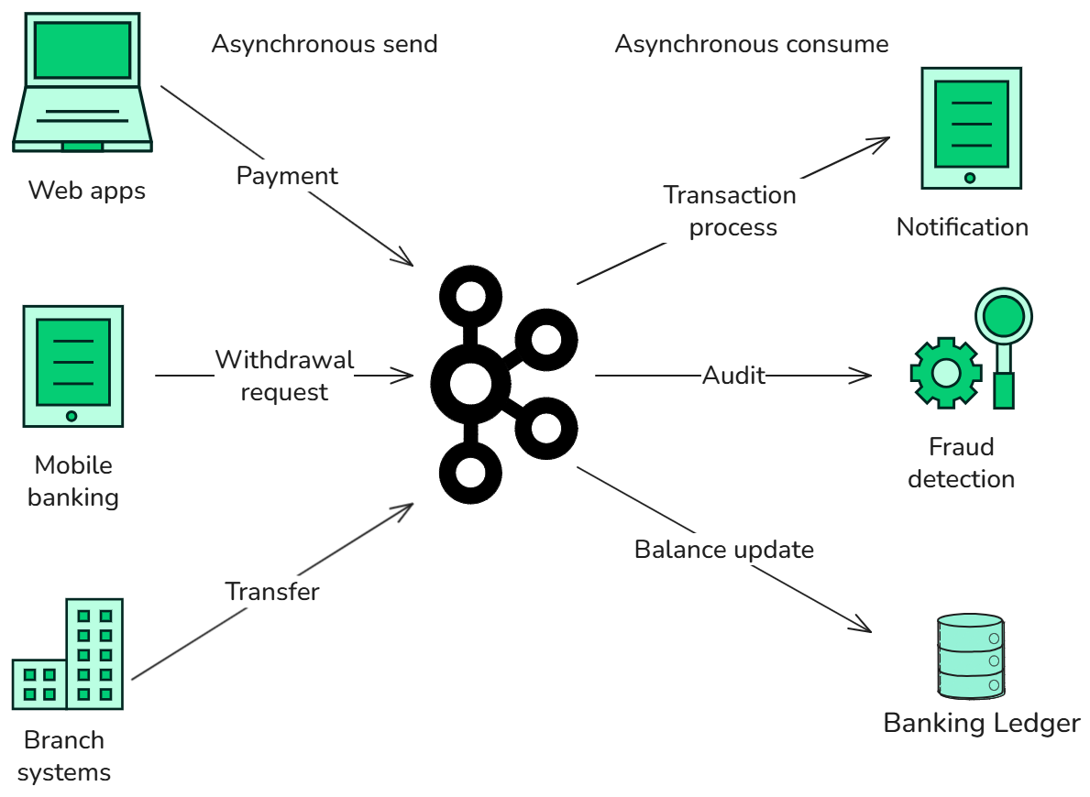
Asynchronous event processing - Banking
Notes:
Okay, I guess you're all familiar with the standard banking example for asynchronous communication via Kafka. All the producers produce events when they feel like it, and the consumers independently consume each event and processes them when they have time.
For our solution at Statnett, we are trying to take this a step further by taking advantage of Kafka's real-time event streaming capabilities.

Slide 12
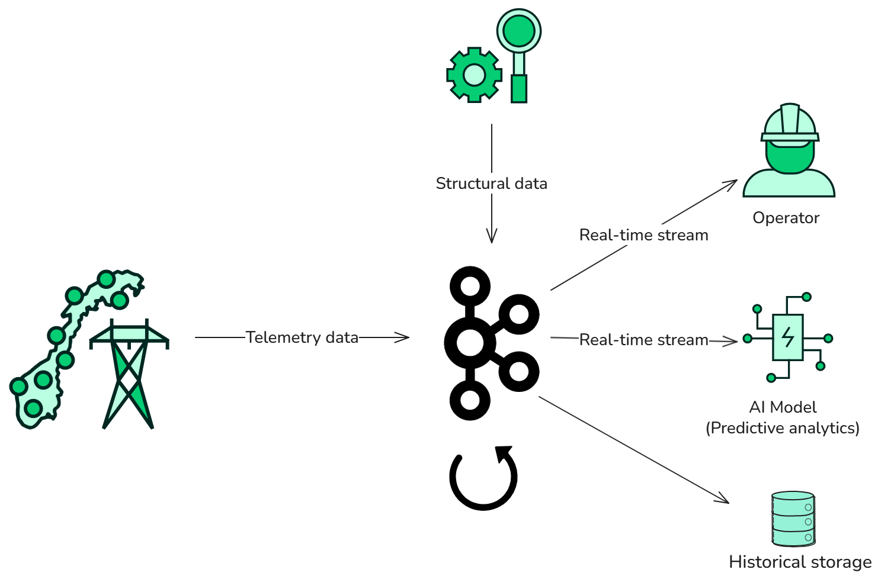
Automatic balancing of the power grid with Apache Kafka
Notes:
This is a really simplified overview over how Apache Kafka is used for the automatic balancing control loop. We got telemetry data from sensors in the power grid coming in from upstreams systems on the left and we get structural data of how the power grid is modelled from the top. The difference worth noting here is that we mainly utilize Kafka Streams in order to aggregate, enrich and filter data in real-time while serving the data to dashboards for the operators and to the forecasting services. The real-time streams are also stored to a lakehouse plattform for historic analysis.

Slide 13
Why Kafka Streams?
It is "just a Java library"
Low latency event streaming in "real-time"
Processor API (PAPI) enables you to implement both stateful logic and stateless logic only limited by your imagination
Out-of-the-box processing guarantees
Out-of-the-box redundancy and failover mechanics
Notes:
So why did we go for Kafka Streams as opposed to for instance Flink?
First off, Kafka Streams is just a Java library making it easy and natural for traditional developers used to running apps on Kubernetes to create Kafka Streams applications, as opposed to Flink which requires that you deploy a job to the Flink cluster.
Kafka streams allows for low latency event streaming in "real-time". Under the hood events are actually streamed as batches, but it satisfies our needs.
The Processor API lets you rather easily build custom logic for both stateful and stateless applications.
And we got both processing guarantees and redundancy out of the box, with for instance topic and state replication.

Slide 14
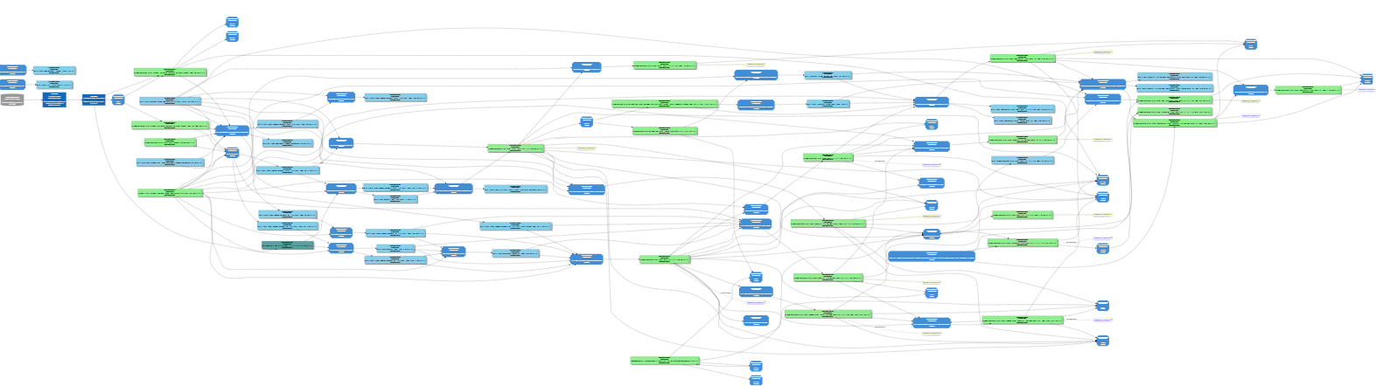
How to meet the balancing needs?
Real-time
Historic corrections
Notes:
This is one of our data value chains consisting mainly of topics and Kafka Streams services aggregating and enriching data. So if you remember the two requirements; available data in real-time and historic correct data, this value chain meets both these requirements by splitting it down the middle. Let me explain…

Slide 15
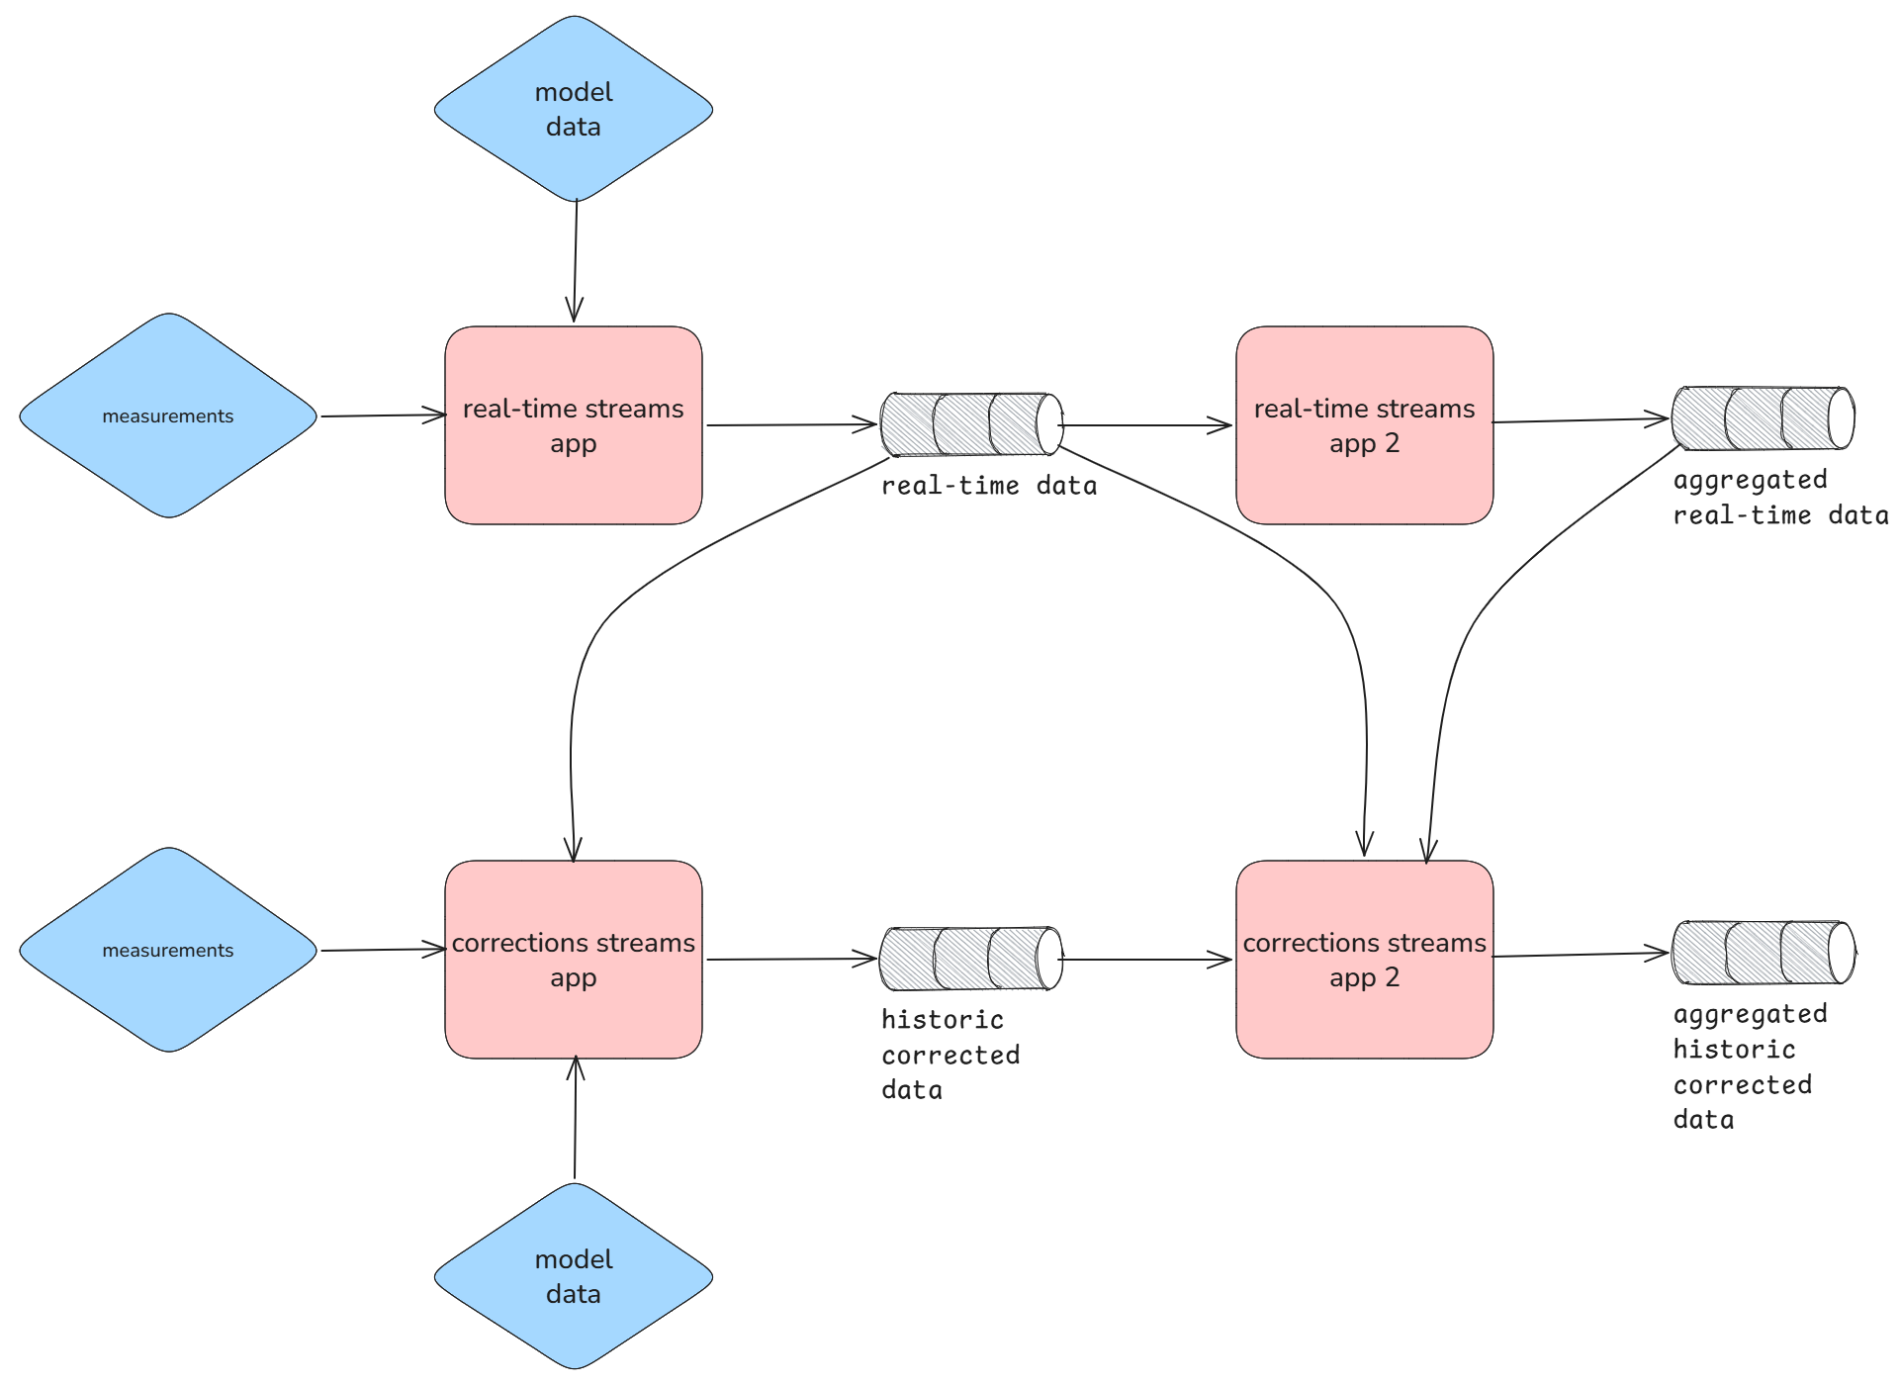
Real-time data and historic corrections
Notes:
The same value chain can be broken down into this diagram. Up top we have the part of the value chain responsible for delivering real-time data. The real-time apps have logic specifically designed for getting rid of lag fast and are only interested in delivering best-effort data that is up-to-date. For instance, it can have a filter early on in the topology removing all measurements that are older than 2 minutes. In that way, we minimize the processing of non-interesting measurements to reduce lag, while also keeping the application state at a minimum.
The corrections chain works as a watch dog for the real-time stream. The corrections chain continously consume/monitor the output from the real-time chain and decides whether it can deliver more correct data, for instance based on delayed upstream data. By dividing the latency requirement and historic correctness requirement into two value chains, we gain
A failover value chain if the real-time chain has downtime
The advantage of specialising applications in each value chain so they only need to answer a single requirement. This leads to the applications being better at actually doing what they are supposed to do, instead of having logic "that does everything". In practice, we have experoienced that this setup has simplified operating and maintaining the value chain.

Slide 16
Observability and incident handling
Notes:
So going back to the original value chain. This is just one value chain in one of the many product teams at Statnett. And as you can see, it is already starting to look a bit chaotic.

Slide 17
Observability and incident handling
Measurements
Product team
Product team
Product team
Product team
Product team
Operator
Service
Service
Service
Service
Service
Service
Service
Service
Service
Service
Service
Service
Grid data
Product team
Product team
Product team
Product team
Product team
Service
Service
Service
Service
Service
Service
Service
Service
Service
Service
Service
Service
Plans
Product team
Product team
Product team
Product team
Product team
Other systems
Service
Service
Service
Service
Service
Service
Service
Prognoses
Service
Service
Service
Service
Service
Service
Product team
Product team
Product team
Product team
Product team
Service
Service
Service
Service
Service
Service
Service
Market data
Service
Service
Service
Service
Service
Notes:
So imagine scaling up to all the different product teams at Statnett, with all of their own applications and value chains with different input data, output data and logic. And as you can see it is all connected. Bad output data from one team can propagate to another team, infecting their data as well.

Slide 18
Observability and incident handling
Measurements
Product team
Product team
Product team
Product team
Product team
Operator
Service
Service
Service
Service
Service
Service
Service
Service
Service
Service
Service
Service
Grid data
Product team
Product team
Product team
Product team
Product team
Service
Service
Service
Service
Service
Service
Service
Service
Service
Service
Service
Service
Plans
Product team
Product team
Product team
Product team
Product team
Other systems
Service
Service
Service
Service
Service
Service
Service
Prognoses
Service
Service
Service
Service
Service
Service
Product team
Product team
Product team
Product team
Product team
Service
Service
Service
Service
Service
Service
Service
Market data
Service
Service
Service
Service
Service
Notes:
So how can we efficiently determine which team or value chain or application is causing bad data in this web of applications and teams?

Slide 19
Statnett's information products
Data exchange between two teams
Must fulfill requirements for documentation, monitoring, data format/schema, discoverability and lineage
Notes:
As a first building block for efficient incident handling, Statnett has adopted the concept of Information Products. An information product is simply data exchanged between two teams, and there are a list of requirements to be allowed to share the data with a different team. For instance, the data must be documented and listed in Statnett's data catalog. By listing up all the Infromation Products in Statnett, we now have a way to determine all the data boundaries between teams.

Slide 20
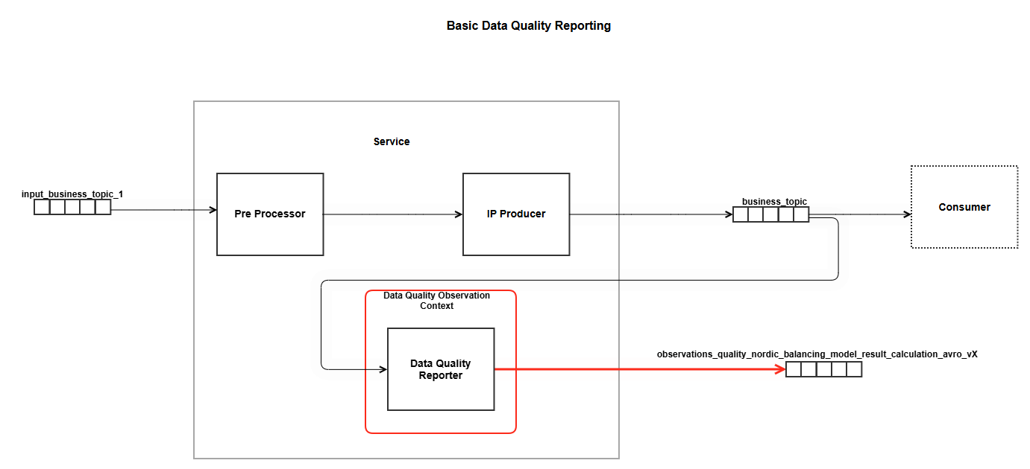
Data Quality Monitoring - Conceptually
DQR-C
METRICS
LOGS
Notes:
The next building block is to set up a centralized Data Quality Monitoring. By creating a separate application, or having the logic in the service itself, that is consuming the Information Product and creating a data quality report produced to a centralized topic, Statnett is able to create metrics and logs for each Information Product. The metrics and logs are produced by a centralized Data Quality Report consumer, and these metrics can then be used to set up automatic alerts and monitoring the state of each Information Product.

Slide 21
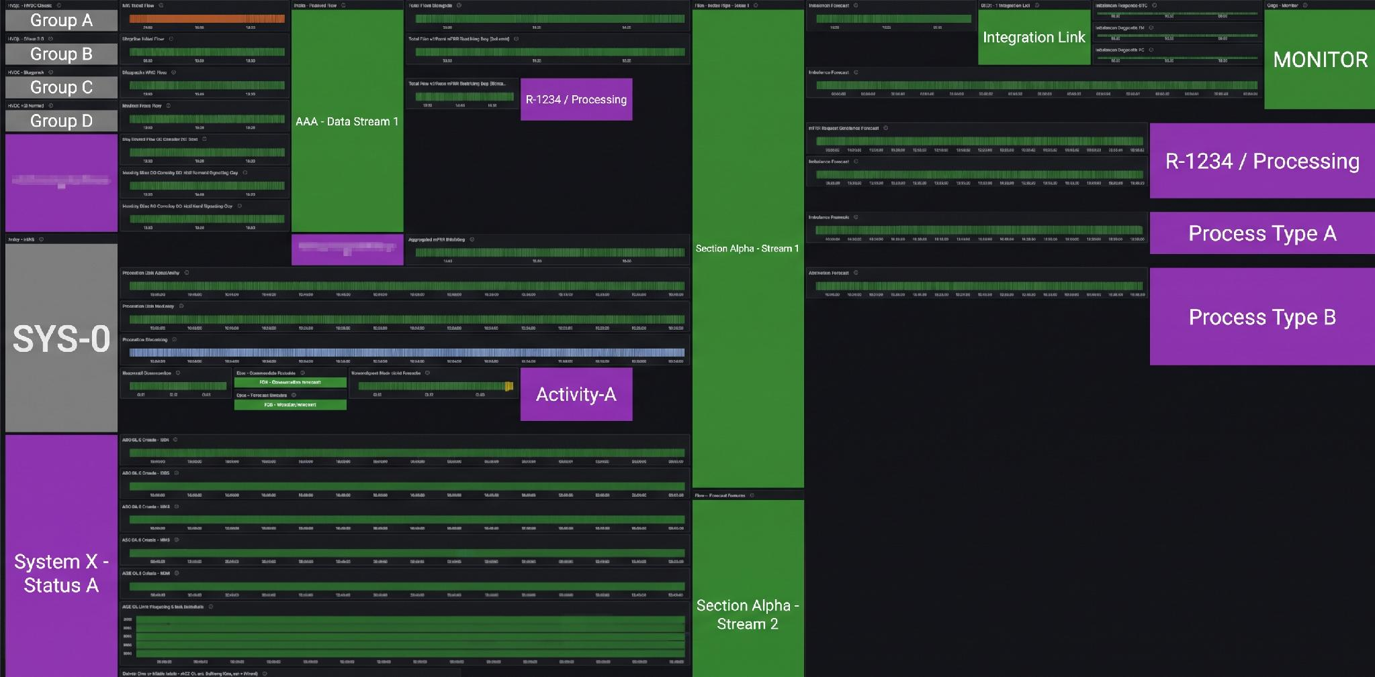
Monitoring in Grafana
Notes:
So by using the metrics, a team consisting of 24/7 awake engineers can setup these Grafana dashboards basically showing the state of all inputs and outputs of every teams, and are able to efficiently pinpoint the root cause or were problems are occurring in the value chain.
This does reqiure accurate monitoring and accountability by each team, but this setup has proven to work pretty well in practice where the hit rate of contacting the correct on-call engineers are high when an incident occurs.

Slide 22
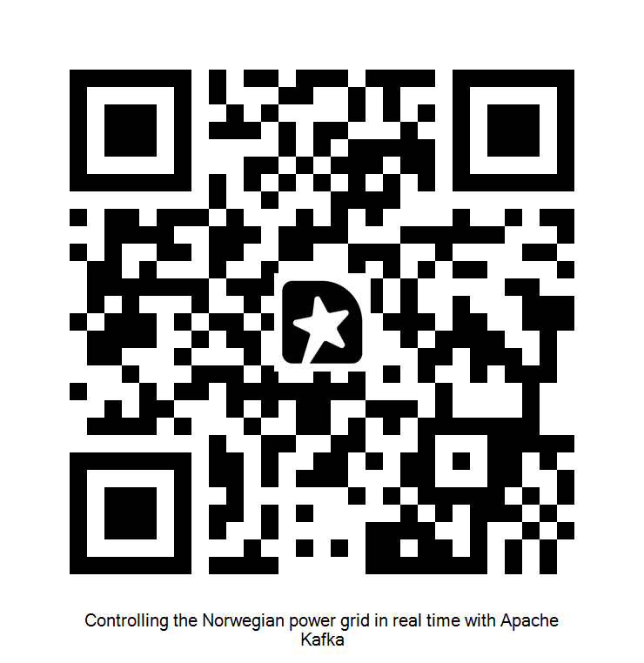
Thank you

